Slide 1


Package Management For
Reproducible R Code

Slide 2
Game Plan
Why is reproducibility important?
What is R? What’s the deal with R packages?
What are strategies for managing R packages?

Slide 3
1439

Slide 4
A little over 500 years later …
Science, business, and many other areas of society continually rely on understanding data, and that understanding frequently involves large and complicated data processes.
Those who receive the results of modern data analysis have limited opportunity to verify the results by direct observation. Users of the analysis have no option but to trust the analysis, and by extension the software that produced it.
This places an obligation on all creators of software to program in such a way that the computations can be understood and trusted. This obligation I label the Prime Directive.
John Chambers, Software for Data Analysis: Programming with R

Slide 5
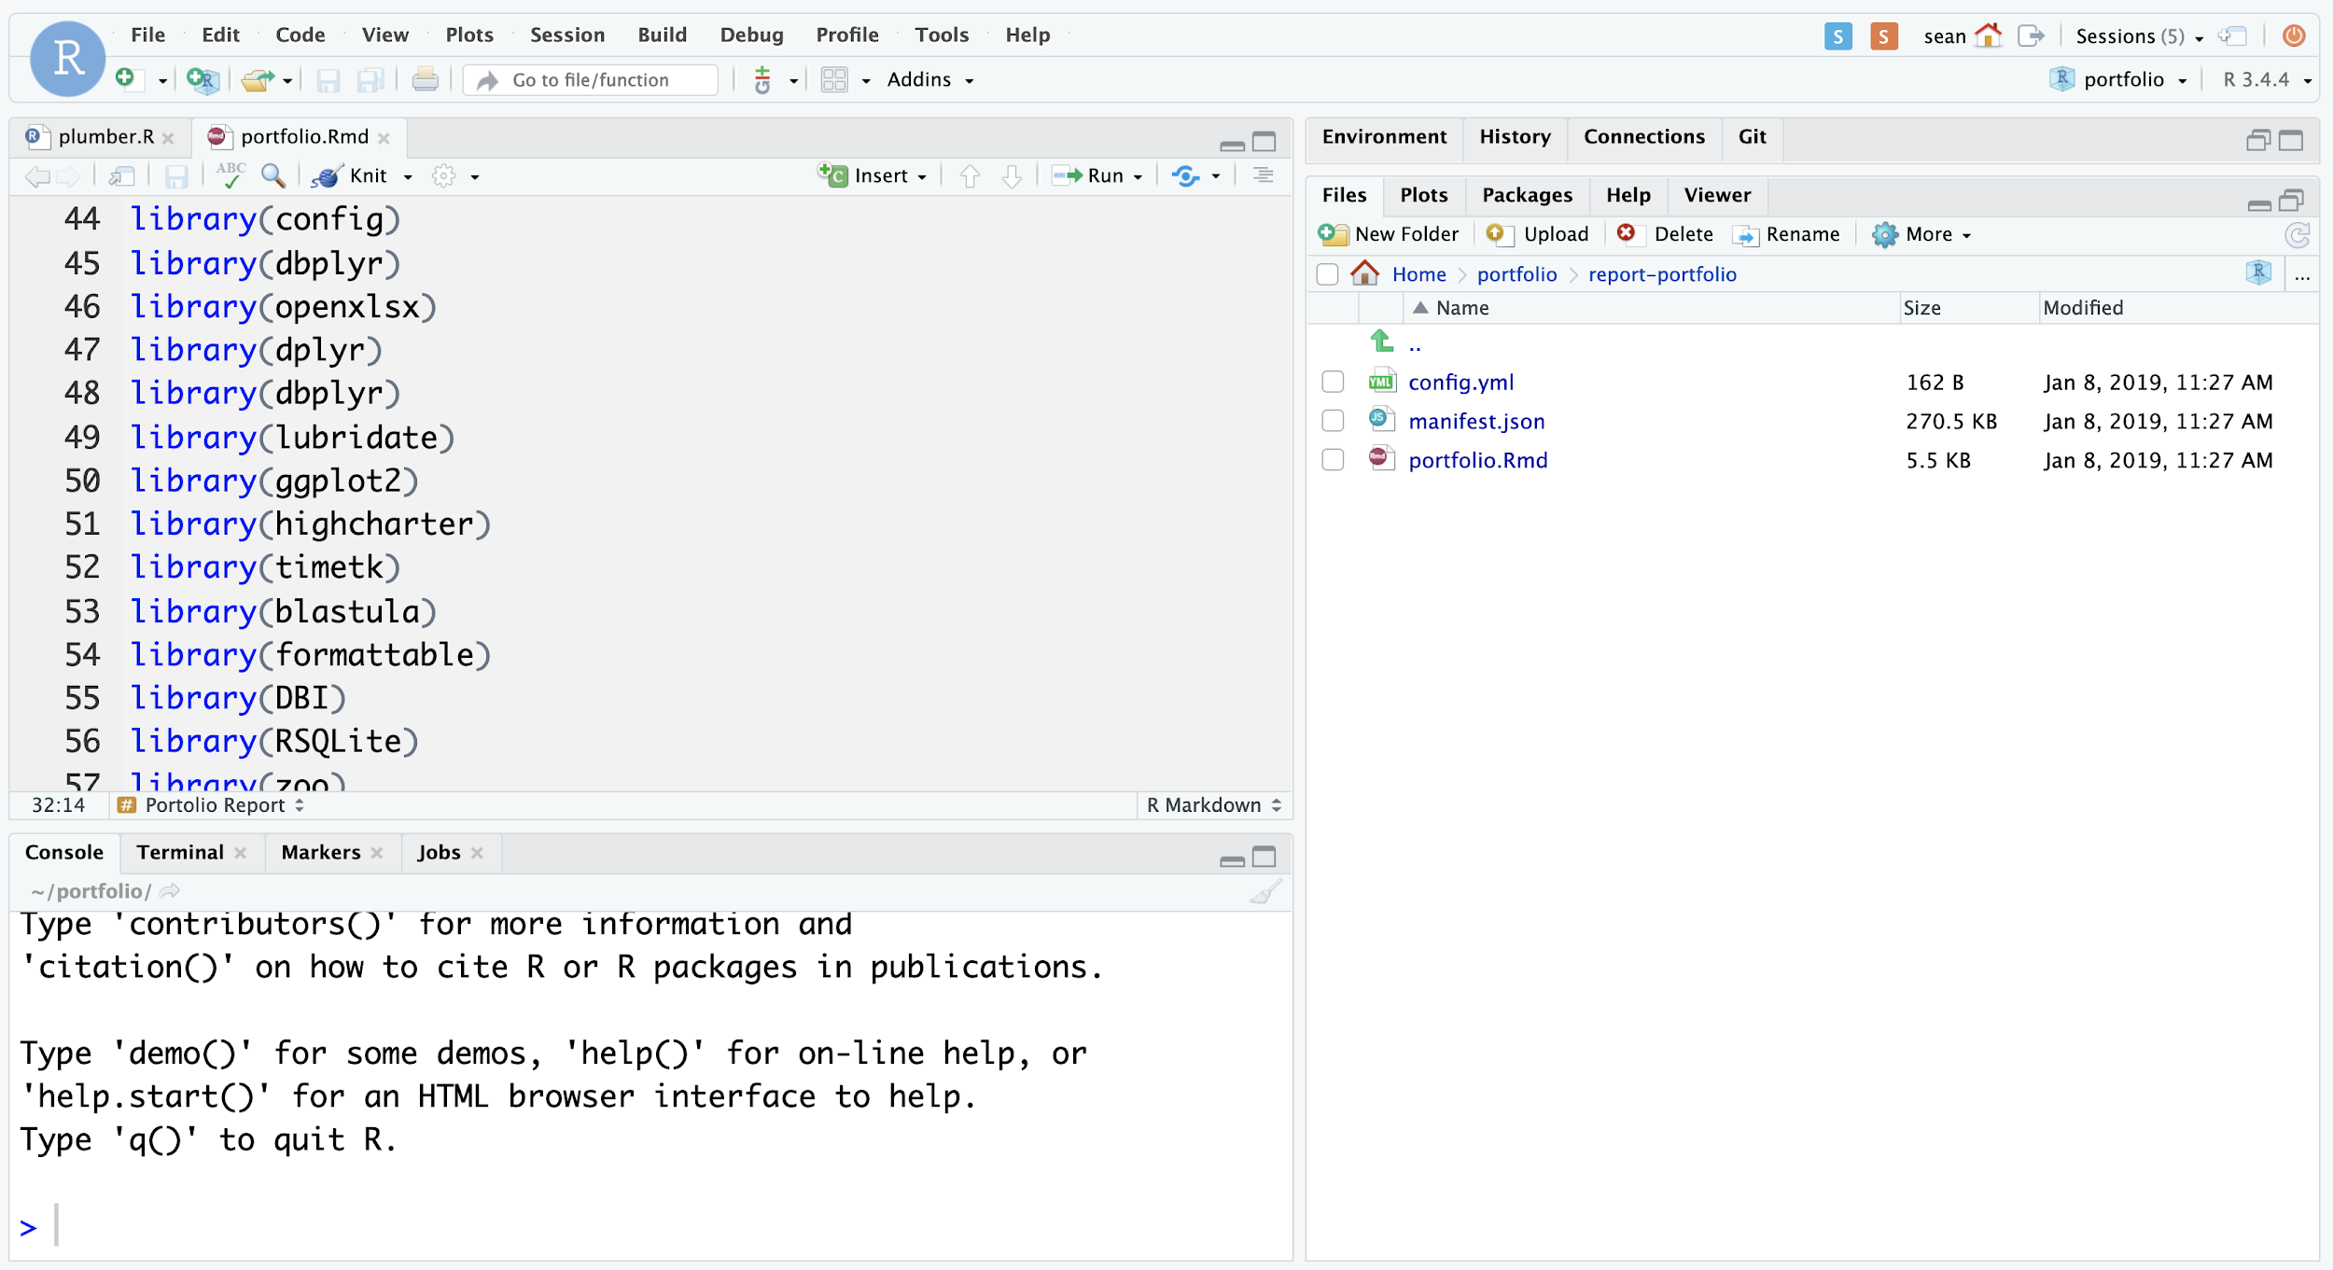
Why are we talking about package reproducibility?

Slide 6
Why are we talking about package reproducibility?
Code
Data
R Packages
System (OS, R Version)

Slide 7
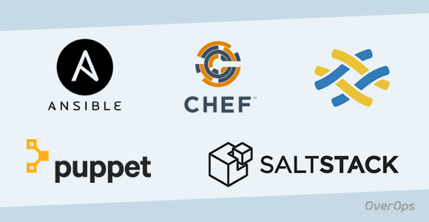

Why are we talking about package reproducibility?
Code
Data
R Packages
System (OS, R Version)

Slide 8
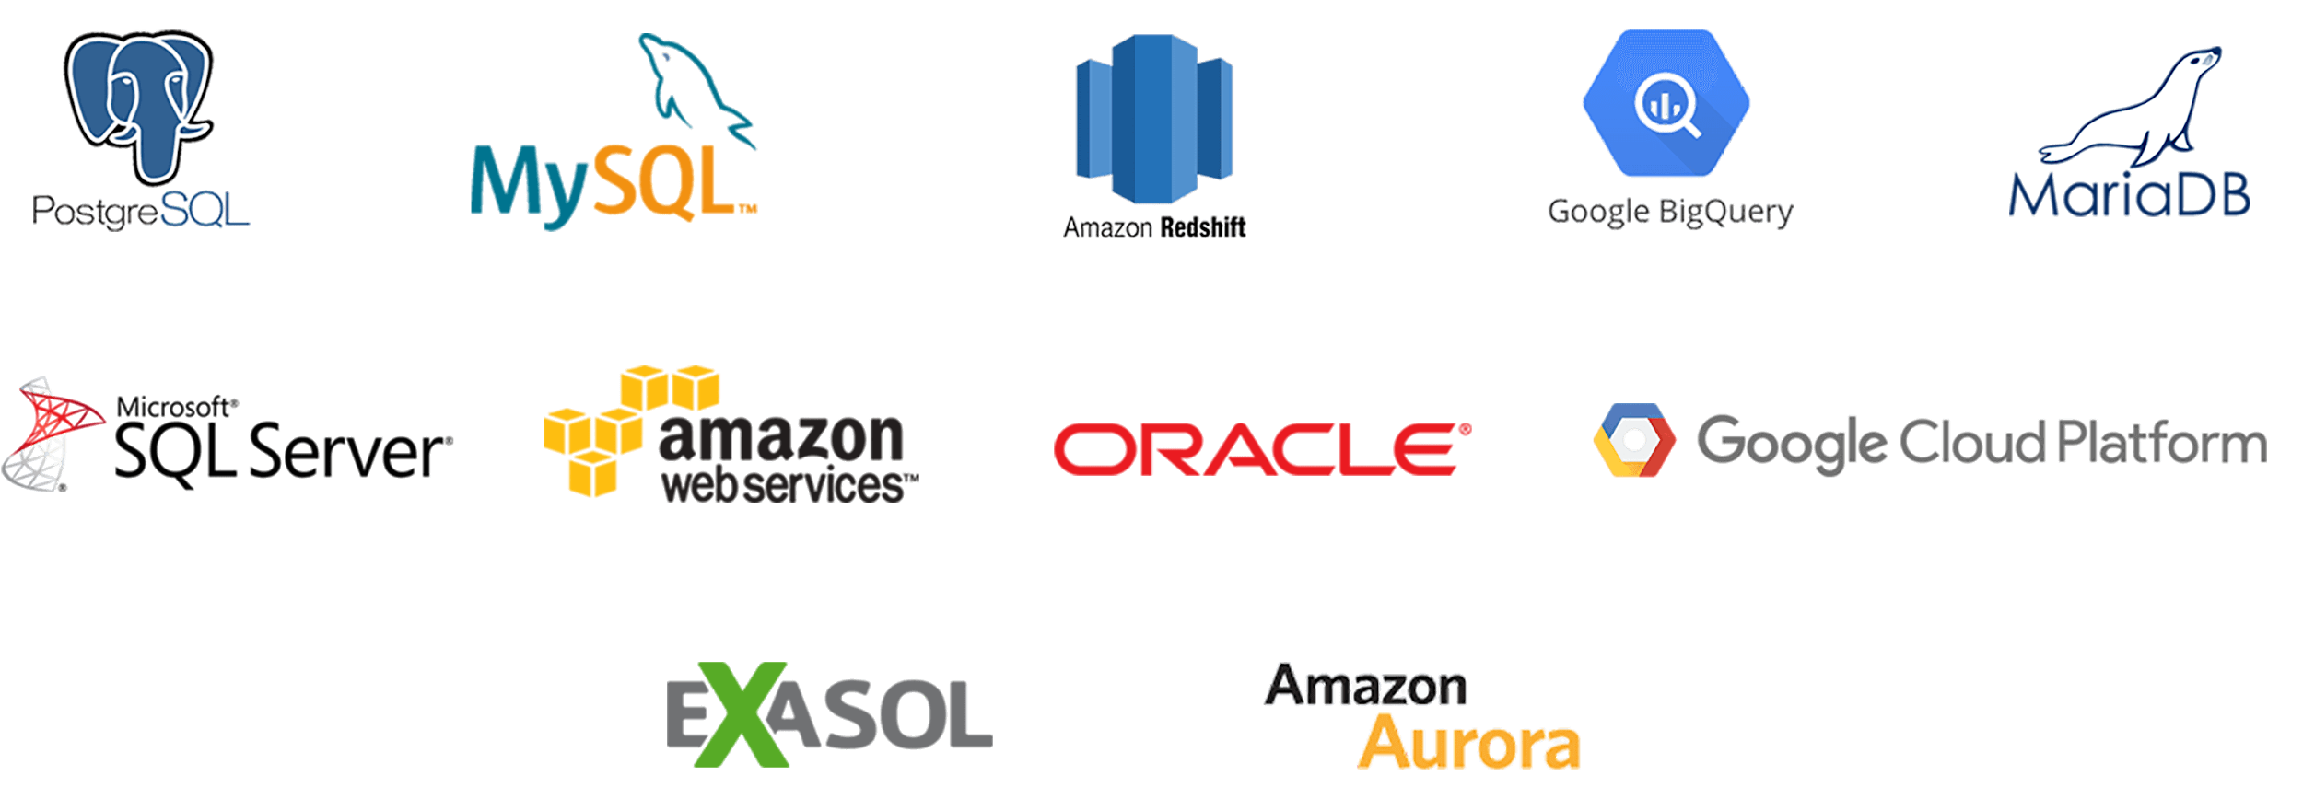
Why are we talking about package reproducibility?
Code
Data
R Packages
System (OS, R Version)

Slide 9

Why are we talking about package reproducibility?
Code
Data
R Packages
System (OS, R Version)

Slide 10
Why are we talking about package reproducibility?
Code
Data
R Packages
?
System (OS, R Version)

Slide 11
Package Management Strategies
Open
Package Access
Locked Down
Admins
Users
Who’s Responsible

Slide 12
Package Management Strategies
Open
“Wild West”
- open access - not reproducible - desktop IDE - how users learn
Package Access
Locked Down
Admins
Users
Who’s Responsible

Slide 13
Package Management Strategies
Open
“Wild West”
Package Access
Locked Down
Admins
Users
Who’s Responsible

Slide 14
Package Management Strategies
Open
“Ticket System”
- slow updates - changes still break things - admin installs into a system
library
“Wild West”
Package Access
“Blocked”
- packages enter through back doors - offline, no plan for package access
Locked Down
Admins
Users
Who’s Responsible

Slide 15
Package Management Strategies
Open
“Ticket System”
- slow updates - changes still break things - admin installs into a system
library
“Wild West”
- open access - not reproducible - desktop IDE - how users learn
Package Access
“Blocked”
- packages enter through back doors - offline, no plan for package access
Locked Down
Admins
Users
Who’s Responsible

Slide 16
Package Management Strategies
Open
“Ticket System”
- slow updates - changes still break things - admin installs into a system
library
“Wild West”
- open access - not reproducible - desktop IDE - how users learn
“Snapshot”
- project based - using packrat - apps/ APIs (RSC)
Package Access
“Shared Baseline”
- new packages every 6 months - updates tied to R updates
“Blocked”
- packages enter through back doors - offline, no plan for package access
“Validated”
- tested subset of CRAN - offline - license restrictions
Locked Down
Admins
Users
Who’s Responsible

Slide 17
Validated
What is it?
Admins give users access to a subset of packages that have been tested or verified.
How do I do it?
Traps

Slide 18
Validated
What is it?
Admins give users access to a subset of packages that have been tested or verified.
Naive: Install packages into a system library Better: Add packages to an internal repository
How do I do it?
Traps

Slide 19
Validated
What is it?
Admins give users access to a subset of packages that have been tested or verified.
Naive: Install packages into a system library Better: Add packages to an internal repository
How do I do it?
Traps
Conflating additions with upgrades

Slide 20
Shared Baseline
What is it?
Admins give users access to all packages, but frozen at one point in time
How do I do it?
Traps

Slide 21
Shared Baseline
What is it?
Admins give users access to all packages, but frozen at one point in time
Naive: Install all packages into a R system library at once Better: Install packages from a frozen repository URL
How do I do it?
Traps

Slide 22
Shared Baseline
What is it?
Admins give users access to all packages, but frozen at one point in time
Naive: Install all packages into a R system library at once Better: Install packages from a frozen repository URL
How do I do it?
Traps
Adding or upgrading packages in the same R version system library
R 3.1
R 3.1
R 3.1
R 3.4

Slide 23
Snapshot
What is it?
Users get access to all packages, and record per-project which packages are used
How do I do it?
Traps

Slide 24
Snapshot
What is it?
Users get access to all packages, and record per-project which packages are used
ISLR 1.1 ggplot2 2.3
dplyr 1.0 Rlang 0.9
How do I do it?
Use a tool like packrat or renv: renv::snapshot renv::restore Along with a repository
Traps

Slide 25
Snapshot
What is it?
Users get access to all packages, and record per-project which packages are used
ISLR 1.1 ggplot2 2.3
dplyr 1.0 Rlang 0.9
How do I do it?
Use a tool like packrat or renv: renv::snapshot renv::restore Along with a repository
Traps
Trying to restore without access to a repository AND package archives

Slide 26
Package Management Strategies
Open
“Ticket System”
- slow updates - changes still break things - admin installs into a system
library
“Wild West”
- open access - not reproducible - desktop IDE - how users learn
“Snapshot”
- project based - using packrat - apps/ APIs (RSC)
Package Access
“Shared Baseline”
- new packages every 6 months - updates tied to R updates
“Blocked”
- packages enter through back doors - offline, no plan for package access
“Validated”
- tested subset of CRAN - offline - license restrictions
Locked Down
Admins
Users
Who’s Responsible

Slide 27
Docker Reproducible
FROM ubuntu
RUN apt-get install \
…
RUN R -e ‘install.packages( … )
RUN R -e ‘install.packages( … , repos = “https://r-pkgs.example.com/cran/189”)’
CMD <some process>

Slide 28
Summary
Package reproducibility is important
Strategies > Tools
There are multiple strategies, pick one based on your goals. Avoid “non-strategies”!
Avoid traps associated with each strategy

Slide 29
Questions
One sentence and end in a “?”

